Slide 1


A NATIONAL MOVEMENT OF GENEROSITY
EST. 2009

Slide 2

WHAT IS THE BIG GIVE ?
THE BIG GIVE IS A NATIONAL NOT-FOR-PROFIT MINISTRY THAT HELPS CHURCHES DEVELOP AN ON-GOING RELEVANT RELATIONSHIP WITH THE PEOPLE IN THEIR COMMUNITY
ON THE FIRST SATURDAY OF JUNE EACH YEAR, CHURCHES OF ALL DENOMINATIONS ACROSS CANADA OFFER A CUSTOMIZED BIG GIVE EVENT, EITHER ON THEIR PROPERTY OR IN THEIR COMMUNITY, TO TANGIBLY SHOW THE LOVE OF GOD THROUGH UNCONDITIONAL GIVING
“By this shall all men know that you are my disciples if you have love one for the other”
John 13:35

Slide 3
OUR MISSION
OUTREACH AND EVANGELISM – HELP PEOPLE DISCOVER JESUS
HELPING THE CHURCH ENGAGE WITH AND BLESS THEIR NEIGHBOURHOOD
SHOWING THE LOVE OF GOD TO THE PEOPLE IN OUR COMMUNITIES
MEETING THE NEEDS OF THE MARGINALIZED
STRENGTHENING THE CHURCH BODY
ENCOURAGING DENOMINATIONAL UNITY
“As we serve, we are not only meeting the needs of our community, we are showing a better picture of who God is”
Kevin Palau

Slide 4
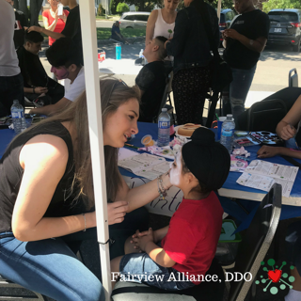
HOW WE DO IT
A NATIONAL UNIFIED DAY OF UNCONDITIONAL GIVING
EACH CHURCH HOSTS THEIR OWN CUSTOMIZED BIG GIVE EVENT
FREE GIVE-AWAY (GARAGE SALE STYLE – EXCEPT FREE)
FREE HAIR CUTS
FREE BIKE REPAIRS AND CAR WASHES
PRAYER TENT
MOVIE IN THE PARK
BBQ’S
KIDS FACE PAINTING, BOUNCY-CASTLES, ANIMAL ZOO
WHATEVER GOD LEADS YOU TO DO

Slide 5
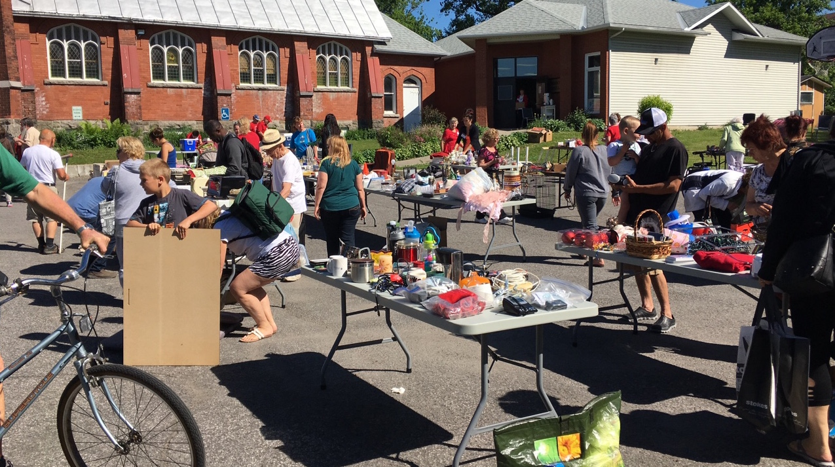
HOW WE DO IT

Slide 6
VALUE & BENEFITS
YOUR CHURCH WILL PARTNER WITH A NATIONAL GENEROSITY INITIATIVE
INCREASE THE IMPACT YOUR CHURCH HAS ON YOUR COMMUNITY
ESTABLISH RELATIONSHIPS WITH PEOPLE WHO DO NOT ATTEND YOUR CHURCH
FOSTER CONGREGATIONAL UNITY AND EXPECTANCY
YOUR WHOLE CONGREGATION CAN BE INVOLVED
OPPORTUNITY TO PARTNER WITH OTHER CHURCH DENOMINATIONS
AS YOU SERVE, YOU SHOW YOUR COMMUNITY A BETTER IMAGE OF GOD

Slide 7
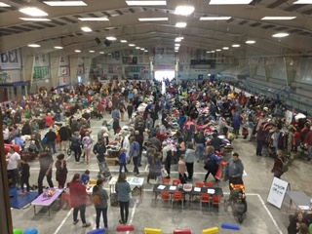
HISTORY
FIRST BIG GIVE 2009
OTTAWA CHURCH – 40 DAYS OF COMMUNITY
OVER 10,000 ITEMS GIVEN AWAY IN 2 ½ HOURS
FURNITURE DELIVERY
SHOES & CLOTHING
BIKES & TOYS
BBQ & LIVE BAND
100’S OF BIBLES
PRAYER BOOTH

Slide 8
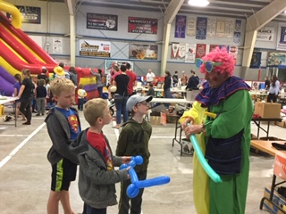
MINISTRY GROWTH
1 CHURCH 2009
55 LOCAL 2015
66 REGIONAL 2016
92 NATIONAL 2017
130 NATIONAL 2018
142 NATIONAL 2019

Slide 9
HOW & WHY WE SERVE
https://www.youtube.com/watch?v=prLc2d1yK4I&feature=youtu.be

Slide 10
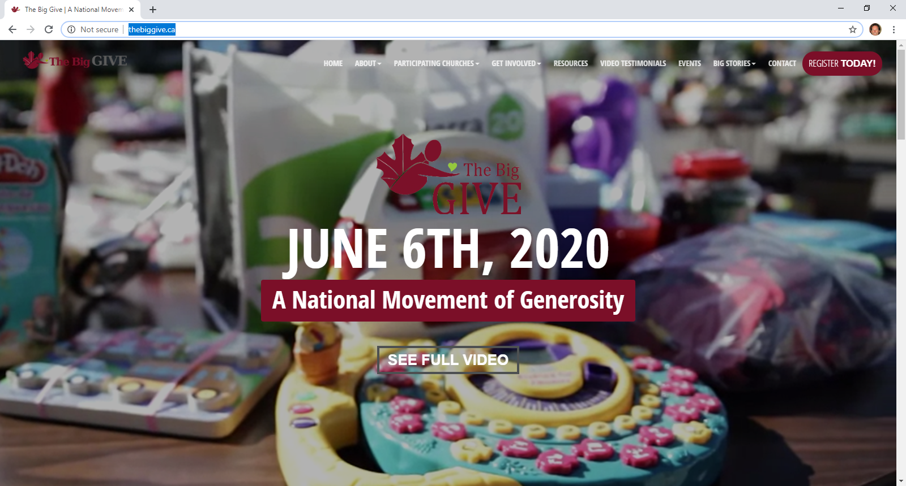
NEXT STEPS

Slide 11



SOCIAL MEDIA HANDLES
Facebook – The Big Give
Instagram – the.big.give
Twitter – @The_Big_Give

Slide 12
Q&A

Slide 13
JUNE 6, 2020

